Slide 1



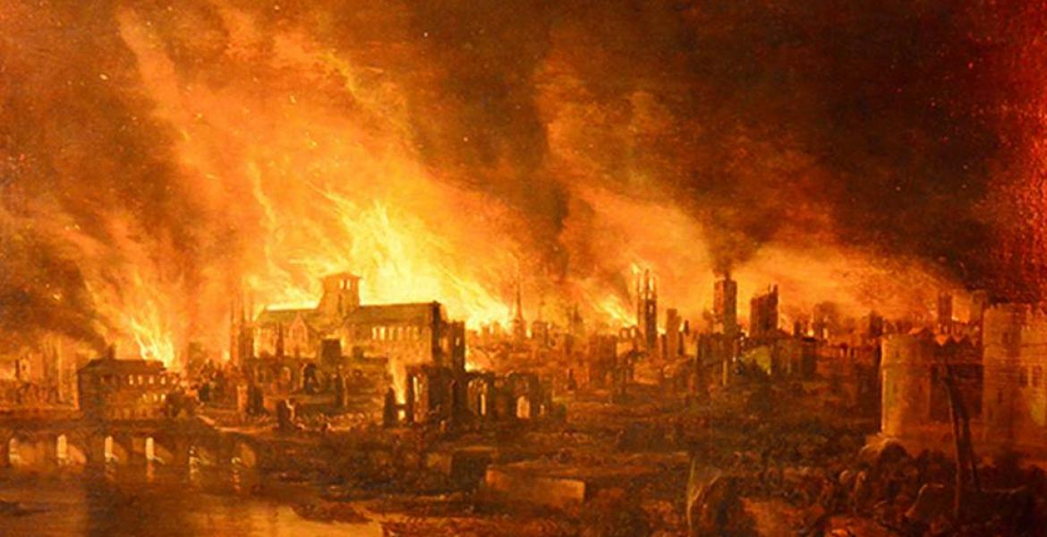



NPA Knowledge Organiser: Year 1 History – Autumn term
Sing a song! ‘London’s Burning’ is a song derived from the great fire of London
https://www.youtube.com/watch?v=5Atpbo3wOts
The Great Fire of London!
What were seaside holidays like in the past? People have been going on seaside holidays in the UK for over a hundred years. Rail travel made it cheaper and easier for people to travel to the coast with their families. Many things that we see at the seaside now such as donkey rides, arcades and buckets and spades have been enjoyed by people of all ages for many years. However, not everything is as it was 100 years ago. For example do you know about bathing machines? They were wooden carts that ladies could get changed in because it was considered rude to be seen in a swimming costume. They were then rolled into the sea and ladies could go straight from the cart into the sea without being seen!
The fire started on September 2nd 1666 and lasted for 5 days!
The Lord Mayor fled the city and King Charles II took control of the fire.
bakery – where cakes, bread and pastries are baked to sell
belongings – a list of items that you own and want to take care of
cart – a wooden vehicle used to carry goods. Often pulled by a horse.
destroyed – to ruin something completely
diary – a personal book used to keep a daily account of event and feelings
escape – to get away from a place where you may be in danger
fire hook – a long pole with a hooked metal head, used to pull down walls or ceilings
London – The capital city of the United Kingdom
Mayor – a person in charge of a town or city
Houses were pulled down and blown up to try and stop the fire from spreading!
The fire started in a bakery on Pudding Lane owned by Thomas Farriner.
The fire destroyed almost 80% of the city of London.
In 1666 houses were packed very close together along tiny, cobbled streets. You could almost touch the neighbours house by leaning out of the window!
Tools
Sing a song! ‘London’s Burning’ is a song derived from the great fire of London
https://www.youtube.com/watch?v=5Atpbo3wOts

Slide 2
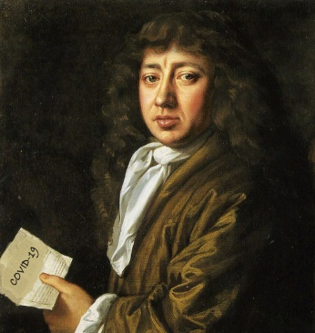
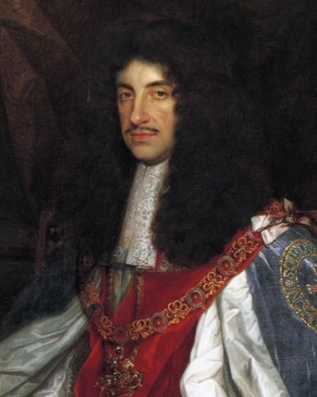
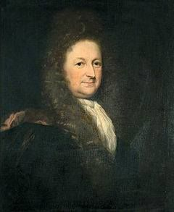

NPA Knowledge Organiser: Year 1 History – Autumn term
Timeline of key events
September 2nd
1am – The fire starts in a bakery on Pudding Lane
3am – Samuel Pepys is awoken and told about the fire
7am – 300 houses have burned and the fire is spreading
10am – Samuel Pepys visits the King to tell him about the fire
September 3rd
4am – Samuel Pepys begins to pack his belongings and move to safety
9am – More people start to flee London as the fire gets out of control
September 4th
5am – The King offers rewards to men who help to stop the fire
8pm – St. Paul's Cathedral catches fire and it mostly destroyed
September 5th
2am – Buildings are torn down and blown up to try and stop the fire from spreading
September 8th
8am – The wind begins to calm and the fire comes to an end
Important People
Samuel Pepys
His detailed diaries kept an account of what happened during the great fire of London. He buried his cheese and wine to keep them safe.
King Charles II
King of England, Scotland, Wales and Ireland in 1649. He made great efforts to help stop the fire from spreading in 1666.
Thomas Bloodworth
The Lord Mayor of London. He was supposed to give orders and deal with important problems in the city of London.
Find out more information about London and the people who lived there and play games at http://www.fireoflondon.org.uk/game/

